Slide 1

AI as Your Strategic Co-Pilot: Advanced Market Analysis and Planning
Empowering senior managers and strategic planners with intelligent AI capabilities.

Slide 2
THE SHIFT
From Retrieval to Reasoning: The Evolution of AI
AI has evolved beyond simple information retrieval. Today's models engage in complex reasoning, analyzing vast datasets to generate strategic insights, predict trends, and support nuanced decision-making.
1
Early AI
2
Modern AI
Information Retrieval & Pattern Recognition
Complex Reasoning & Strategic Synthesis

Slide 3

REAL-WORLD APPLICATION
Deep Research with OpenAI's Agents
OpenAI's advanced research agents exemplify AI's cognitive capabilities. They can autonomously scour vast information sources, synthesize findings, and generate comprehensive reports on complex topics, mirroring human analysts but at unprecedented speed and scale.
Autonomous data aggregation
Cross-referencing diverse sources
Synthesizing complex information
Generating executive summaries

Slide 4
DELEGATING COGNITIVE TASKS
Your AI Research Assistant: A Step-by-Step Guide
Seamlessly integrate AI into your strategic workflow by delegating time-consuming, cognitive-heavy research tasks.
1
Define Scope
2
Provide Context
Clearly articulate your research question and objectives for the AI.
Supply relevant background data and any specific parameters.
3
Iterate & Refine
4
Synthesize & Act
Review initial AI outputs and refine prompts for deeper insights.
Incorporate AI-generated findings into your strategic plan.

Slide 5
STRATEGIC FRAMEWORKS
AI-Powered SWOT Analysis Generation
Leverage AI's analytical power to rapidly generate robust SWOT analyses using structured prompts. This accelerates your planning cycle and ensures a comprehensive view of internal and external factors.
1
Strengths
2
Weaknesses
Internal capabilities and advantages.
Internal limitations or disadvantages.
3
Opportunities
4
Threats
External factors that can be leveraged.
External factors that could pose challenges.

Slide 6



TOOLKIT
Strategic Analysis Template Library
Access a curated library of AI-driven templates to streamline your strategic assessments. These pre-configured prompts enable quick generation of detailed analyses.
SWOT Analysis
PESTLE Analysis
Competitive Intelligence
Strengths, Weaknesses, Opportunities, Threats
Political, Economic, Social, Technological, Legal, Environmental
Market positioning and competitor insights

Slide 7

WORKSHOP
Hands-on Exercise: Building Your SWOT Prompt
Practice crafting effective prompts to guide AI in generating a tailored SWOT analysis for your specific business context.
Prompt Example: "Generate a SWOT analysis for [Your Company Name], a [Industry] company specializing in [Key Product/Service]. Consider recent market trends in [Specific Market Trends] and the impact of [Recent Industry Event]."
Task: Work in groups to write a detailed AI prompt for a SWOT analysis relevant to your department or a hypothetical business scenario.

Slide 8
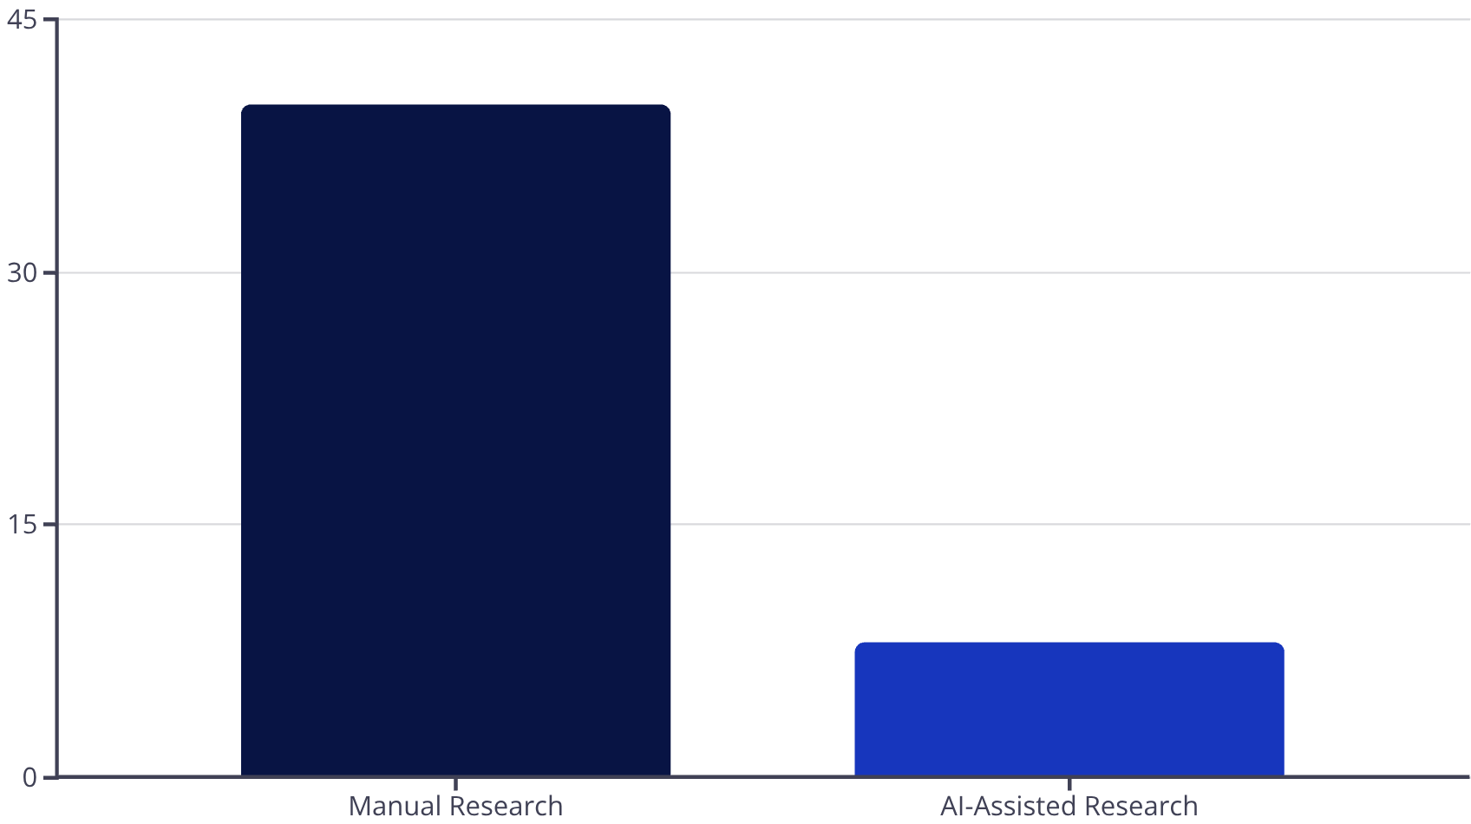
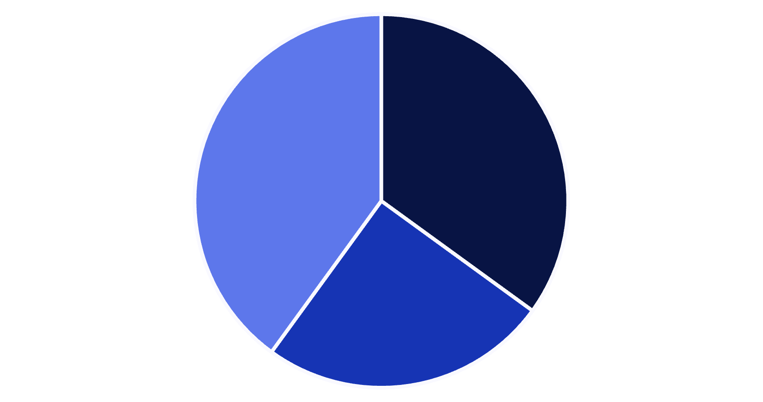
MEASURABLE IMPACT
Quantifying ROI: Time Savings & Quality Improvement
AI as a strategic co-pilot delivers tangible returns through reduced analysis time and enhanced output quality.
Time Saved
Quality Improvement
Comprehensiveness
Accuracy
Depth of Insight
AI can reduce the time spent on initial data gathering and synthesis by up to 80%, freeing up your team for higher-value activities.
AI enhances the depth and breadth of analysis, leading to more robust and data-driven strategic decisions.

Slide 9




KEY TAKEAWAYS
Empowering Strategic Decision-Making
Cognitive Delegation
Enhanced Insights
AI handles heavy lifting in research and analysis.
Deeper, faster, and more comprehensive strategic intelligence.
Measurable ROI
Strategic Co-Pilot
Significant time savings and improved analysis quality.
AI as an indispensable partner for senior leaders.

Slide 10

NEXT STEPS
Integrate AI into Your Strategic Workflow
Ready to transform your market analysis and planning? Here’s how to begin your journey with AI as your strategic co-pilot.
Pilot Program: Identify a key project for AI-assisted analysis.
Team Training: Equip your planners with prompt engineering skills.
Platform Integration: Explore tools and platforms that best suit your organizational needs.
Continuous Feedback: Iterate and refine your AI workflows for optimal performance.

